Slide 1
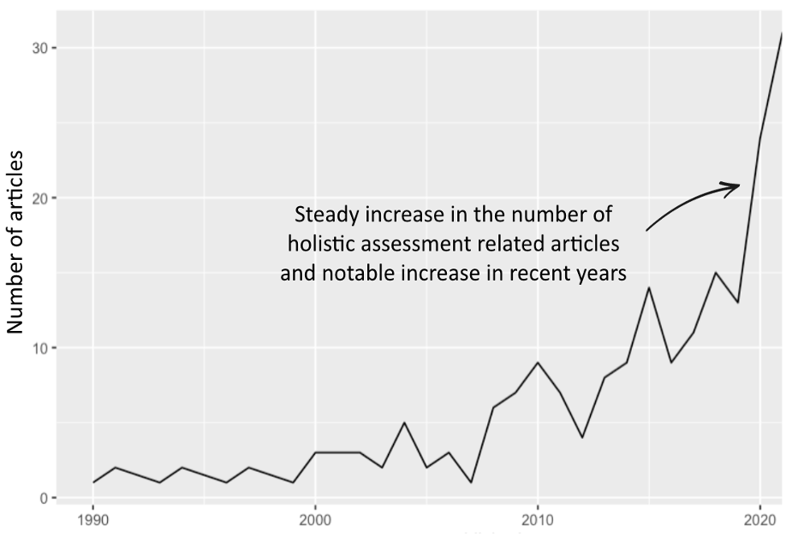
METRICS, METRICS EVERYWHERE…
3,225 articles screened
206 holistic assessments evaluated
Over 6000+ metrics identified
All look at multiple dimensions (environment, social, economic)
Most assessments focus on farm scale; few look at the project of food system scale
Rarely involve stakeholders from the start. Instead, elicit feedback once metrics have been decided.
Few assessments looked at interactions. Many use composite indexes and radar charts.
More are one-off snapshots, few look at changes over time.

Slide 2


Four requirements for holistic assessment
By developing holistic metrics that account for multiple impacts, we can create a level playing field for agroecological approaches and enable sustainable transitions
Multiple dimensions
At least some economic, social & environmental aspects
Multiple Perspectives
Multiple views of the system
Industrialised Agriculture
Agroecology
Synergies and Trade-offs
Allows analysis of synergies and trade-offs through time
Emergent Properties
Includes assessment of emergent properties such as sustainability, equity and resilience
Equity
Climate Change
Bio-diversity
Soil Health
Yield

Slide 3
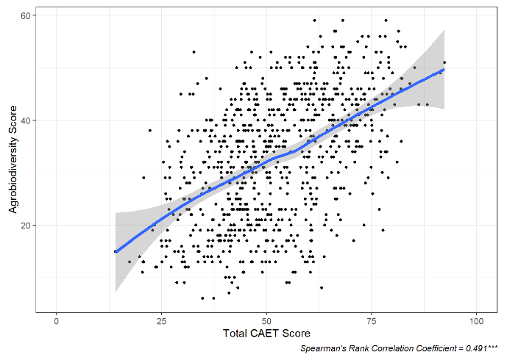
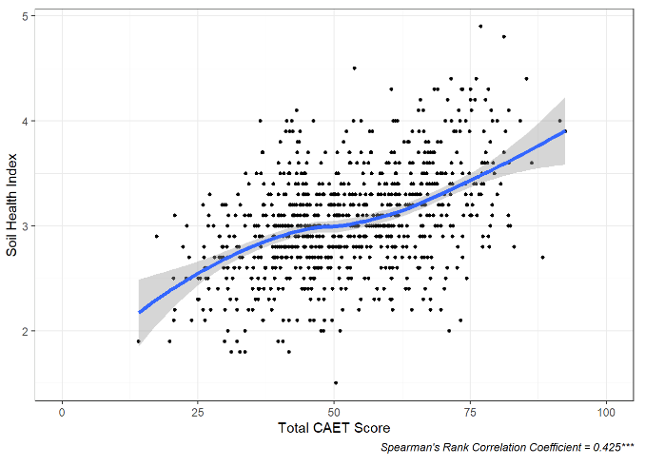
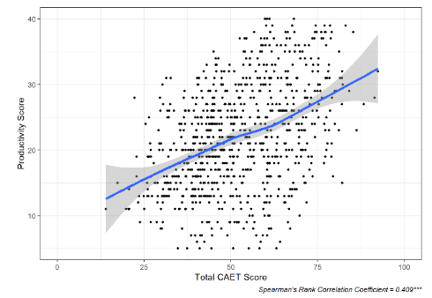
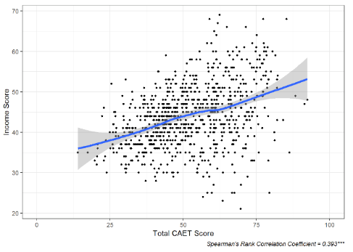
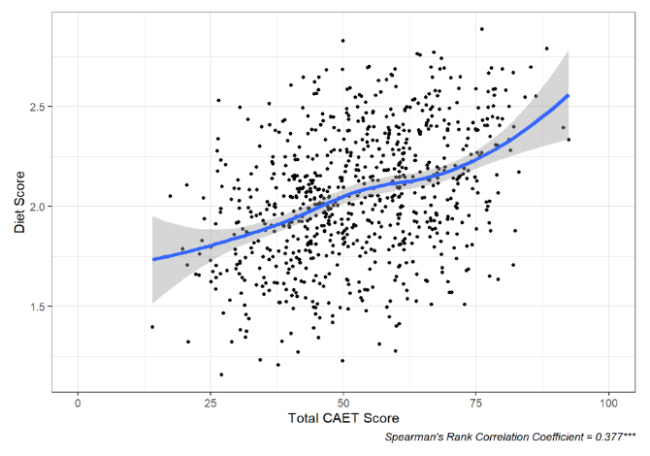
Agroecology status correlates positively with both productivity, income and environment
TAPE + LDSF applied on 839 farms in Benin, Ethiopia, Kenya, and Madagascar
soil health
agrobiodiversity
More agroecological
food security and dietary diversity
productivity
net income

Slide 4
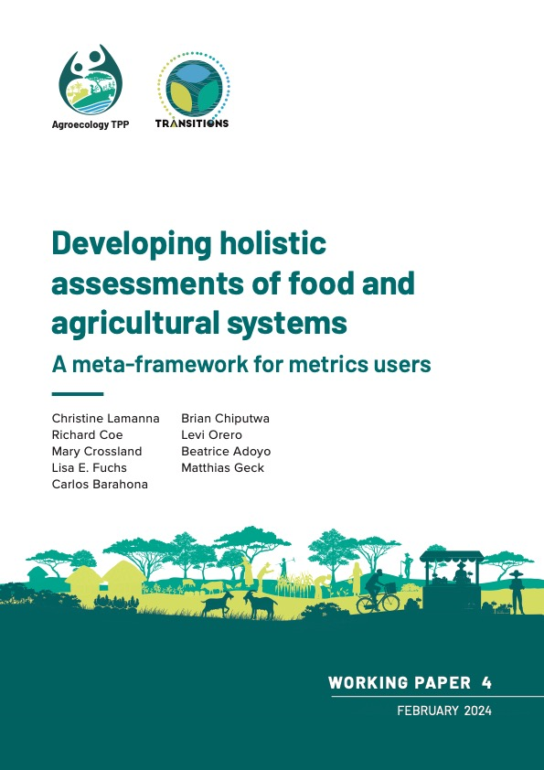



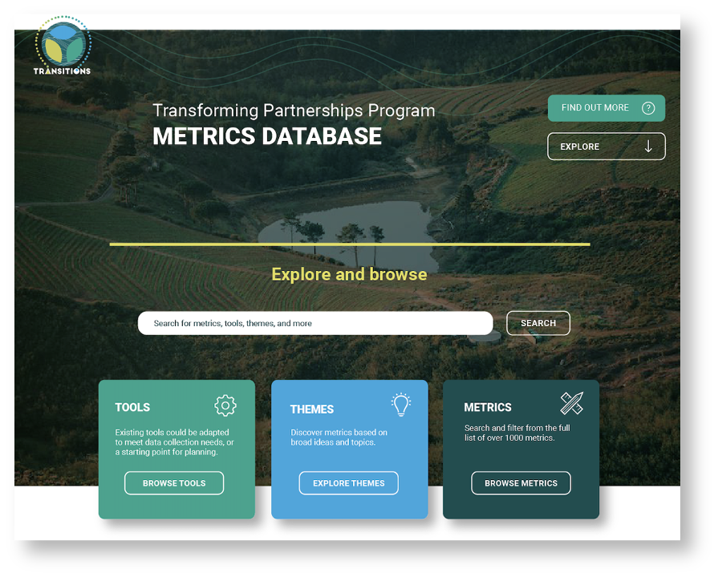


The Meta-framework
Build your own holistic assessment!
View and download the Meta-framework here!
Meta-framework link
Database teaser link
Notes:
We released the metaframework as a working paper earlier this year, and have been using it as a basis for engaging with and supporting projects designing assessments as a way to ”road-test” the tool. We’re currently in the process of developing further material for the final part – and engaging with partners is helping us further develop the tool
(move on at 1:10)

