Slide 1
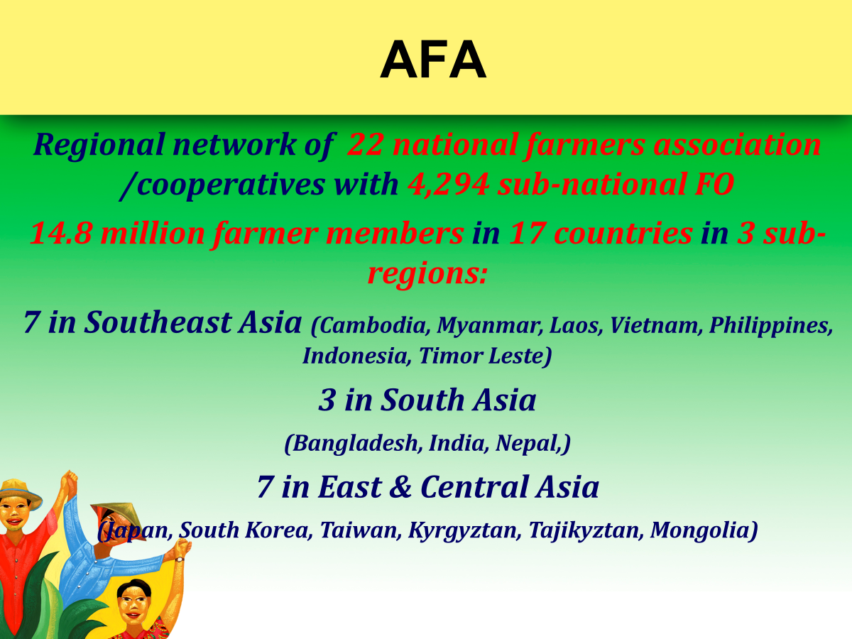
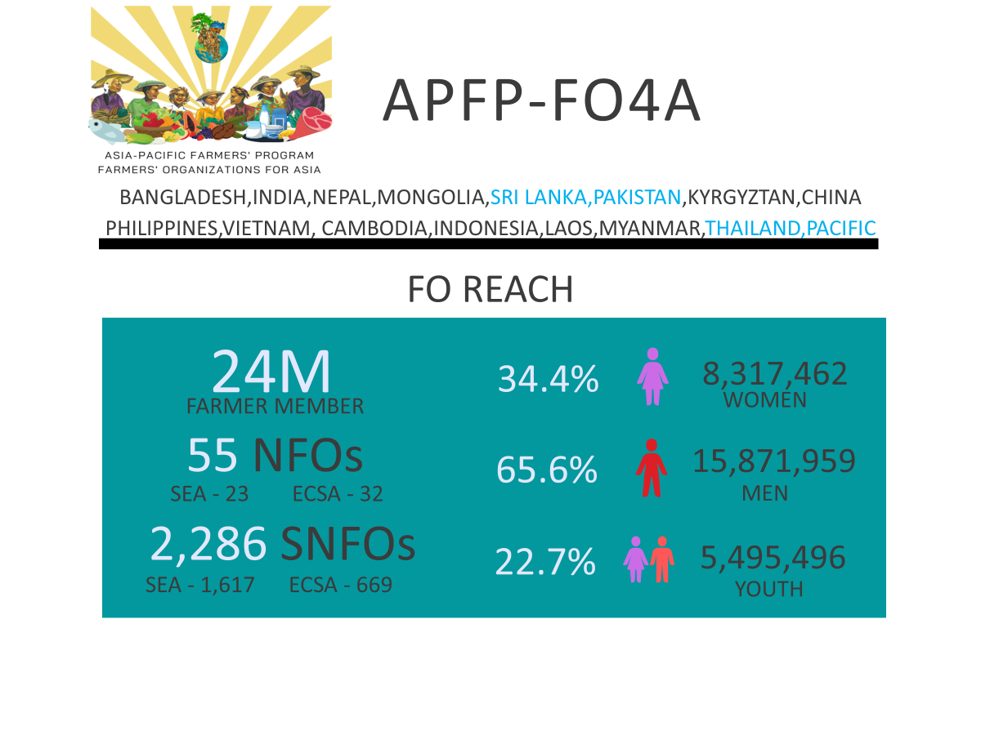
Brief Overview of AFA: FO Members and Partners

Slide 2
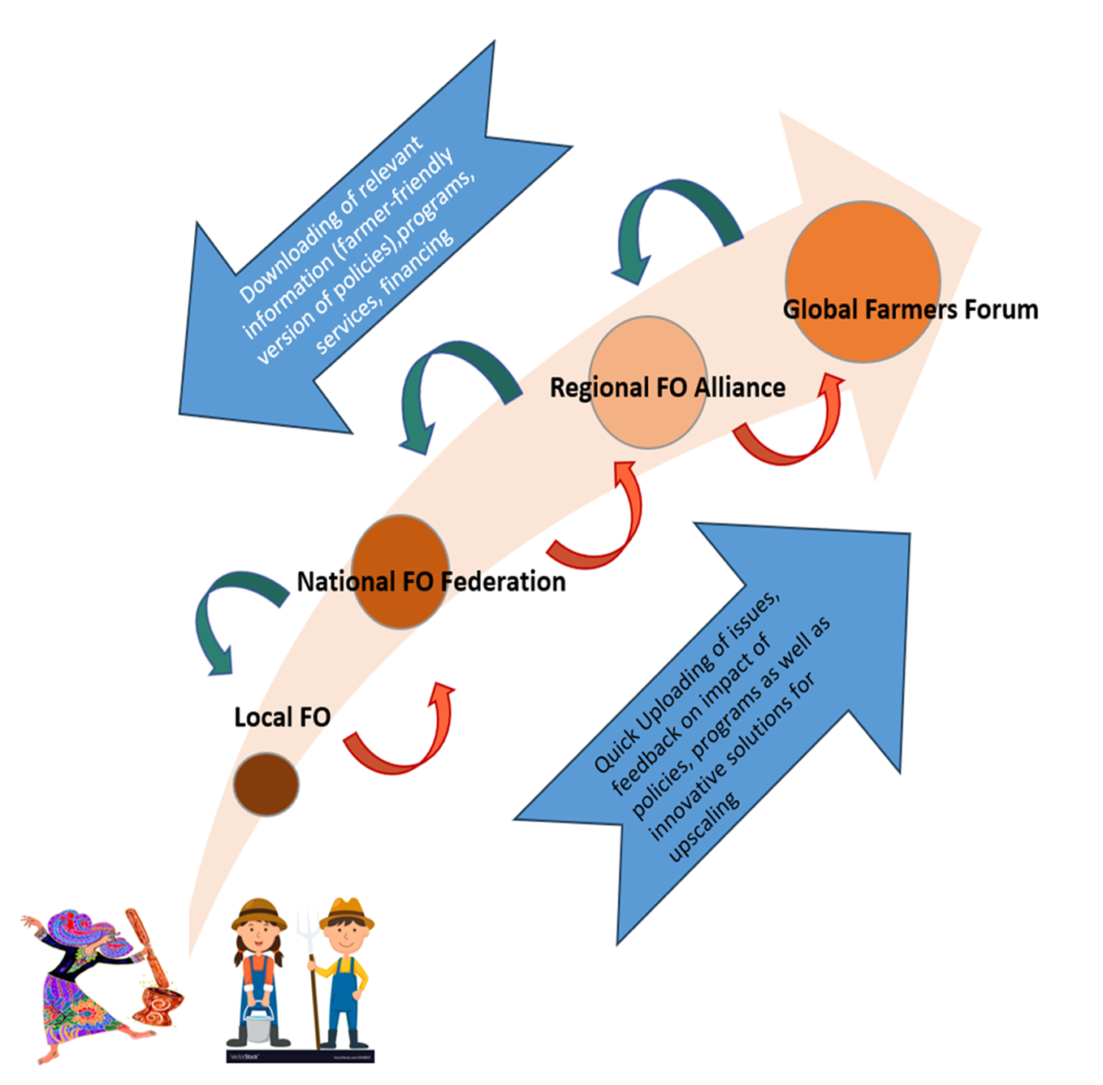
Maximizing FO structure for Economic Services, Policy Engagement; Capacity building, Knowledge Management

Slide 3
Support FOs as they engage in national-level actions and processes
Support CSO and FOs within NCFFs by
  Facilitating peer-to-peer learning
  Linking FOs and CSOs with regional and global dev’t partners
  Mobilizing resources to support CSO/FO processes and activities (e.g. monitoring)
GLOBAL
(UNFCC, UNCBD, CFS, FSS, IFAD, FAO, TPP AE, AE Coalition; plus GAFSP)
REGIONAL
(ASEAN, SAARC, FAORAP, IFAD APR)
NATIONAL
(NLC, NCFF, APFP, FAO and IFAD at the country)
Consolidate policy recommendations and key messages
Develop joint statements and declaration
Participate in the following key events and mechanisms: Climate conference, CBD, UNDFF Global Forum, CFS/CSIPM, TPP, AE Coalition
Engage with:
Regional bodies – ASEAN, SAC
Development agencies/financial
institutions – IFAD, FAO
Contribute to developing policy recommendations, key messages, and joint statements directed to regional and international bodies.

Slide 4
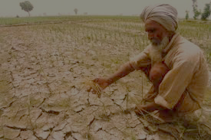
Differentiated FO Role & Business Model at various level
Targeted Services | Primary FO | Sub-national | National Network | Regional FO Network
Target Client | Individual Farmers | Primary FO | Primary FO/Sub-national | National FO
Type of services
- Capacity building | Farm Planning | Business Planning | Value-Chain Management | Peer to peer cross country learning
- Production support | Input supply Agri-extension | Common Service Facility (CSF) FFS / | Farmer Technician Dev’t Local Learning | Regional commodity-based Forum (ACBF-coffee/coconut)
- Marketing assistance | Collective marketing | Aggregation of product -commodity clustering | E-commerceBuilding Market matching Processing | Cross-country Coop-to-Coop Product exchange -EUDR Compliance
- Financing | Financing to Individual Credit and savings | Financing support to District FOs/Coops Pooling of savings | Insurance Loan to Provincial network | Challenge fund / recoverable grant to support
- Advocacy | Local policies | Provincial policies/ordinances | National Policies | Global policies
Source of income / Financing and Sustainability | Membership fees and service fees from individual | Annual dues and service fees from district FOs | Annual dues and service fees from sub-national Network | Annual dues and service fees from NFOs and partners

Slide 5
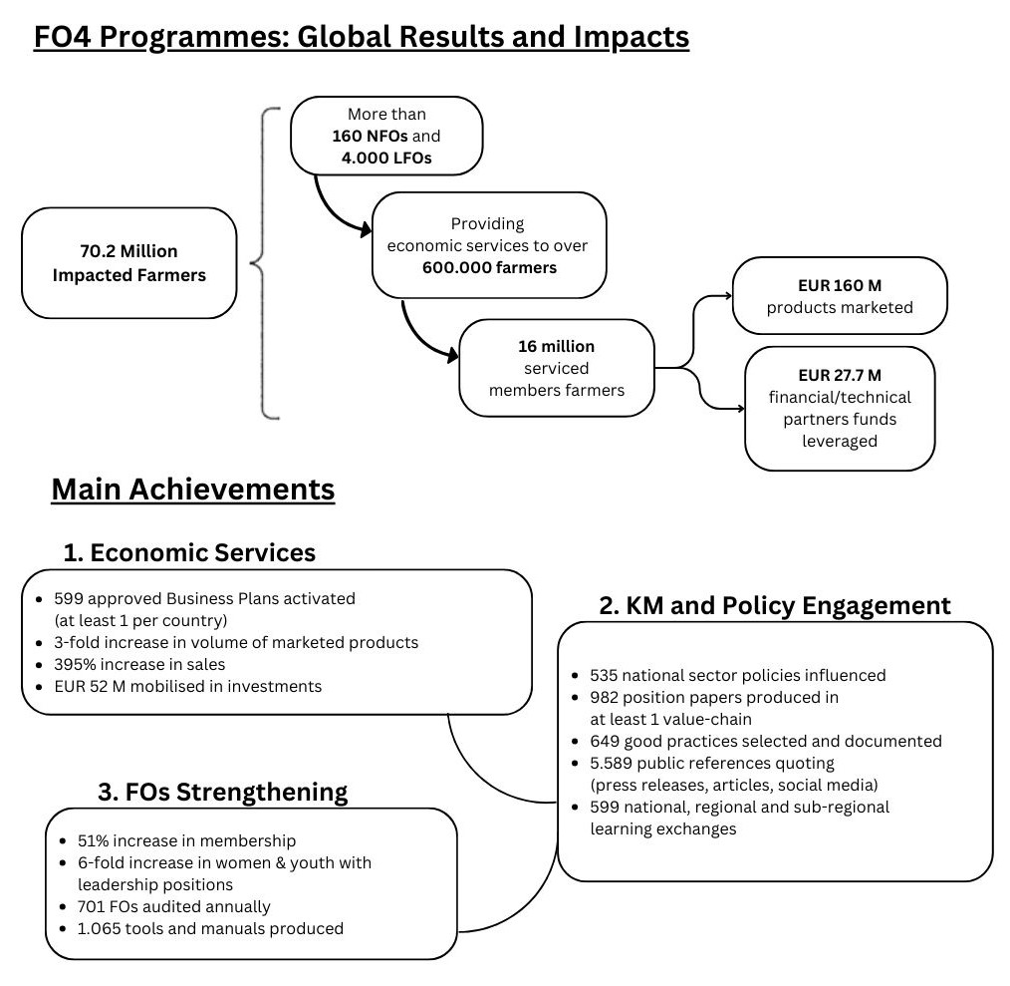
Strengthening Farmers’ Organization (FO4) Program (Africa,Carribean,Pacific, Asia,Latin America)

